Slide 1
Pokemon Stats
Carlos Cuevas, Betsy Shane, Adrienne Lewis, and Ebony Martin

Slide 2

Data
Pokemon stats from Kaggle
721 pokemon from 6 generations
CSV to SQLite DB
Replaced blank cells with zeros
Notes:
CSV had a variety of information about the pokemon such as Type, Gender, HP, and Defense.
We loaded the CSV data into a SQLite database. We had some problems at first where only about 642 pokemon were being loaded into the database. We weren’t exactly sure why some pokemon were loaded and some weren’t so in all the blank cells we put a zero. Populating the blank cells allowed all 721 pokemon to be loaded without any problems.

Slide 3
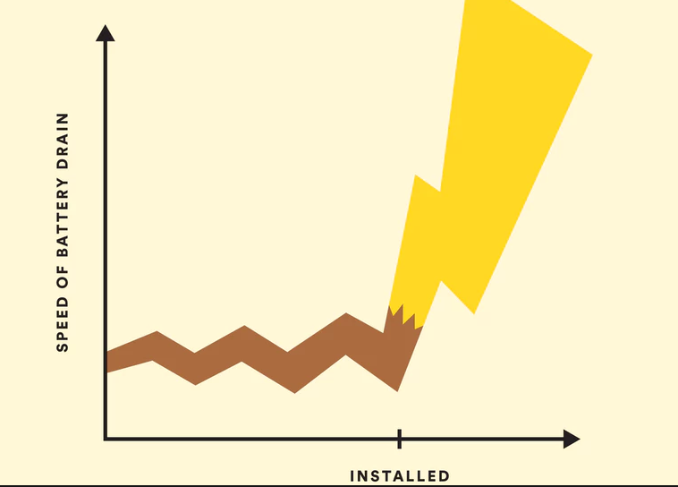
Code
Belly button homework
Flask and Javascript
Chart routes
Chart types
Notes:
We took the belly button homework and applied that to our dataset to make an interactive dashboard with dropdowns.
In the Flask file we created a class that contains the DB model. The DB model allowed us to create the routes that link to each chart type and the associated data for the charts
In our Javascript file, we created how our charts will look based on the routes in our Flask file. The HTML contains the CSS and the dropdown that allows us to switch between charts.
Based on our data, we decided to have 3 bar charts and 1 scatter plot.

Slide 4

Dashboard
https://pokemon-test-app.herokuapp.com/

